Slide 1

Back to School
&
Our New Bank Draft Payment System

Slide 2
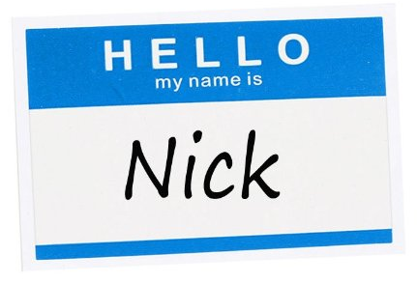
Introductions
Please tell us:
Your name
Your job title
What’s your favorite hobby?
Notes:
B.

Slide 3
What We’ve Accomplished
Texas Education Code – Right to a Duty Free Lunch, Planning & Prep Time, and so forth.
Fought off vouchers (which would siphon money out of the public school system) for DECADES!
Fought for and passed Safe Schools Act (for classroom staff, as well as bus drivers)
Protected class size caps of 22 for K-4.
…and we can do much more, when we all stand together!

Slide 4
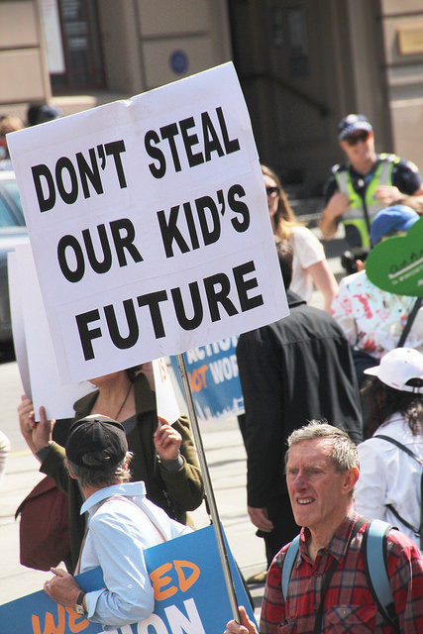
A History of Anti-Public Education Legislation
SB 1968
  Bill brought up to eliminate payroll deduction
  Written by the same team that wrote the legislation that decimated teachers in Wisconsin
  Was stopped… just barely.
Other states under attack
  Louisiana, Missouri, Michigan…
....and now it’s back!
  More to come??
  Both the governor and lt. governor have put payroll deduction as priority for review.

Slide 5
Bank Draft: Why We Are Switching to a New System
To keep each other protected from anti-union/anti-public education attacks.
To have resources to fight those who want to destroy public education.
To ensure we have a voice in school districts and in the state house.
To guard against the coming attacks against our healthcare, pensions, and charter schools.
To protect our careers, lives, and families that depend on us.
If we are not able to stand up and advocate for our students and our schools no one will!

Slide 6

Rather than wait for the passage of adverse legislation stripping us of payroll deduction, we have decided to empower our members to own their power and convert to alternative dues payment by bank draft.
Our Message: Own Your Power

Slide 7
What Do We Do For Back to School?
NTO- New Teacher Orientation, an event specially designed for new and new to the district teachers. These can range in size from a couple dozen people to several hundred.
Convocation-All employees in a district are invited. It is part orientation, training, and celebration to kick off the new year. Hundreds to thousands can attend depending on the size of the district.
Professional Developments-Mix of employees attending various trainings, size ranges from a few dozen people to several hundred.
Employee Fairs-These are setup as vender fairs and are usually very large. Employees come through in waves and things move very quickly. A wide variety of organizations and business can setup at a fair, all vying for attention.
We also attend employee breakfasts, clinics and anything else the district will let us into.

Slide 8
Campaign Goals
Our goal is to recruit 100% of new members to bank draft system.
As volunteers in central Texas you will be reaching out to potential members in districts throughout the region.
You will be informing potential members about the benefits of joining AFT and signing them up through bank draft.
If you speak with a current member you will discuss the Own Your Power campaign and give them the opportunity to convert to bank draft!
Accurately assess 100% of potential and current members that you speak with as to their willingness to join using bank draft.

Slide 9
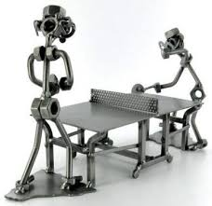
Campaign Nuts & Bolts

Slide 10
Back to School Event Logistics
Phase I: Setup & Greeting
It pays to get there early. Generally you will be allowed to setup 30-1 hour before the event starts. If there is not a setup time designated by the district, plan on being there about an hour early.
Depending on the size of the event there may need to be a team dedicated to greeting and funneling teachers back to the AFT table. Districts have different rules governing if you can leave your table and when employees can be approached ranging from extremely lax to ridiculously strict. Often it is better to ask for forgiveness.
Whether you go out into the crowd or stay at the table, start by welcoming the employees to the district. You will have very little time to make an impression. Be ready with materials and get the conversation started- Ask if they are new to the district or if this is their first year teaching? Or if they have heard of AFT?

Slide 11
Back to School Event Logistics
Phase II: Our Message, Moving People to Membership & Crowd Management
Need to be able to explain the value of being an AFT member and differentiate AFT from other organizations quickly and succinctly. Many of the people you speak with will have no background knowledge about AFT or unions in Texas. Using the Comparison Chart as a visual aid can be helpful.
Keep the flow going. As people start filling out their applications have them move to the side. May need two teams. One to talk to people as they come by the table and one to help people fill out their forms and answer questions.

Slide 12
Back to School Event Logistics
Phase III: Transition and Next Steps
Have the new member fill out as much information as they can on the application and make sure they sign the form. If they do not have their banking information, explain that an AFT representative will follow up in the next 24-48 hours to activate their membership and get their missing information.
The representative will use the contact information provided so make sure it is legible. Our rep will also confirm their identity before activating their membership.
Give them their new member kit and the Next Steps-Member Activation Sheet. Explain that if they do not activate that day then they will have up to 5 days to activate or it will become void.
Remind them of any future events AFT may be hosting in the district.

Slide 13
Back to School Event Logistics
Phase IV: Breakdown
Stay until everyone else has gone or you are asked to leave. Often we catch people leaving the events and there may be more time to talk. If you are covering multiple events in one day then part of the team may need to split off so you stay on schedule. This should be discussed ahead of time and the lead will make the final call on when to pack up.
Try to pack up neatly. You or someone else will be using the kit again. Make a note of any items you are running low or out of and be sure to tell the lead.
Debrief away from other groups or employees after the event.
Be sure to turn in all forms at the end of the day. The lead will be in charge of sorting them and collecting any assessments.

Slide 14
Back to School Event Logistics
Phase V: Following up
If the person doesn’t sign the form or doesn’t want to give their information over the phone then you need to schedule a follow up appointment with them. Please set a specific date and time and let them know that someone will contact them to confirm. This follow up should be made as soon as possible. Ex: later that day.
Someone from the office will contact all of the follow ups and activate their membership. Once we have the information needed to complete their application we will send the new member an email to officially welcome them to the union and confirm their membership.
It is extremely important you get people to fill out the forms as much as possible during the event and that you double check the contact information.

Slide 15
Great! So How Do I Talk to Others? (Recap)
Introduction – Introduce yourself. Welcome them to the district and the event. Establish credibility.
Ask Questions – Identify if they are a first year teacher or returning, even if from another district.
Get Them to the Table – Introduce them to AFT resources and benefits, and raffles. Get them to the table! Ex: Share My Lesson, First Book etc…
Connect Issues to opportunity/Agitate- Highlight what makes AFT stand out. Time allowing, identify the issues that move them and agitate around those issues.
Secure a Commitment – also known as the “Ask” – will they join TODAY to protect their voice, their union, and their power. Ask them to donate to COPE.
Close – Next Steps: Make sure you each have relevant contact information, make sure they have the activation card, and/or scheduled a follow up, leave any educational/visual materials behind and be clear what the follow up will be. Give them New Member Kit when applicable. Thank them for their time.

Slide 16
Tips for Having a Successful Conversation
Express a sense of urgency – we cannot wait
Use what you know. If you don’t know, ask!
  We each have our own story, our own concerns and priorities. What will be important for one person may not be as important to another – so try to speak to the individual about how being a member would affect them.
Know the frequently asked questions and be prepared to answer them. (Will Review)

Slide 17

Tools We Need
Membership Application
NTO Information Worksheet/ Assessment Forms/Debrief Forms
Own Your Power swag
Dues Rate cheat sheet
Local Information cheat sheet/Comparison Chart
State Literature/Brochures
Activation Form
Member Lists
Staff Contact Sheet
Lead Kit Checklist/Kit

Slide 18
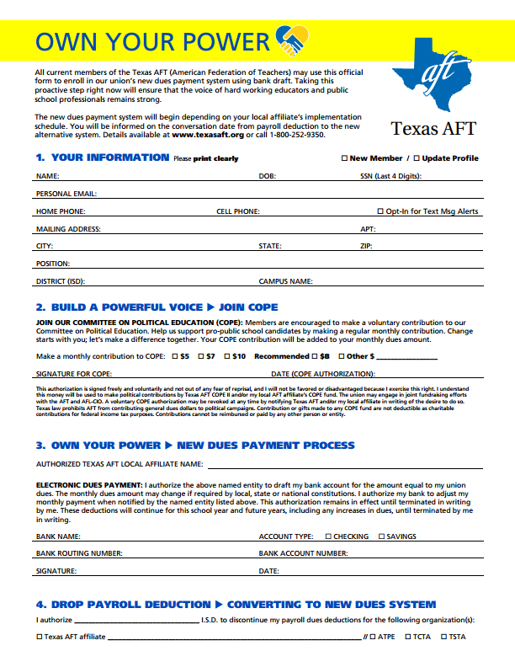
What to Know on the Form
Make sure the Update Profile or New Member Box is checked.
NAME
COPE
BANK INFO
Payroll Drop
LAST 4 OF SSN & Initial

Slide 19
Assessment Scale
1= Switched to bank draft/Joined
2= Filled out form but needs to activate membership. Scheduled a follow up or phone call.
3= Undecided who has been asked, but has not filled out a form. Has not given a firm No.
4= Refused to join. Dues issue, joined another organization etc…
Important for everyone to be assessed the same way- My Yes Shouldn’t Be Your Maybe.

Slide 20

Role Play

Slide 21
Campaign Expectations
Wear appropriate attire.
Wear an AFT identifier
Daily team debriefing after each event and fill out form
Lunch
Turn in all applications at end of each day – no exceptions
Campaign schedule may change depending on the needs of the campaign. Please check your schedule nightly!
Be on time!
Restock lead kits daily
Never leave candy in the car!

Slide 22
What You Need To Do To Be Reimbursed By AFT
Make sure you have filled out the following forms prior to starting work with AFT:
FW4
I-9
AFT Employment Enrollment Form-Direct Deposit
You will need to have a blank check and valid drivers license.
2. Once you start working you need to track your mileage and hours using the below forms:
Mileage Log
Volunteer Stipend Form

Slide 23
Volunteer Stipend Form (Time Card)

Slide 25
What You Need To Do To Be Reimbursed By AFT
Stipend and Mileage forms are due every Monday no later than 12pm with one exception. July 1st is the due date for their last week worked since Monday is a holiday.
Mileage Log and Reimbursement form must be typed. Handwritten mileage forms will not be accepted or processed.
Volunteer Organizers will be paid on the 15th and the last day of the month. If the pay period falls on a Saturday or Sunday they will be paid the Friday before.
Last payday will be July 15th.
All paychecks will be direct deposited to their accounts. Paper checks are not an option for payroll.

Slide 26
Your Campaign Calendar
August 2016
Sunday | Monday | Tuesday | Wednesday | Thursday | Friday | Saturday

Slide 27
This union is only as powerful as
YOU
make it!
Notes:
27
You should not wait around for someone to start the process for you. Don’t wait for your principal to recommend this. Don’t expect someone else to keep your documentation. This law is intended for the teacher to take action, not someone else.

